Slide 1
Mediation Ethics
Produced for LawLine
June 26, 2016
New York Law School
ADR Day – Bridge the Gap
By: Simeon H. Baum, Esq.
Resolve Mediation Services, Inc.
(www.mediators.com)
&
Dan Kolb, Esq.
DavisPolk

Slide 2
CARTOON: ETHICS

Slide 3
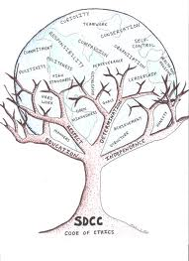
Defining Ethics
Not Easy!
Moral philosophy: a branch of philosophy that involves systematizing, defending and recommending concepts of right and wrong conduct.

Slide 4
Quite a Range
Philosophical ethics investigates what is the best way for humans to live, and what kinds of actions are right or wrong in particular circumstances.
Meta-ethics (epistemology, meaning, ontics)
Normative ethics (actions – good? bad?)
Applied Ethics - draws upon ethical theory in order to ask what a person is obligated to do in some very specific situation, or within some particular domain of action

Slide 5
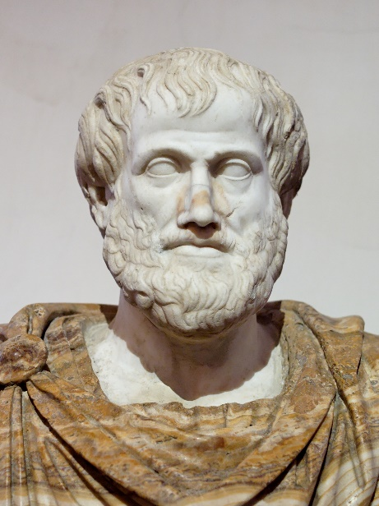
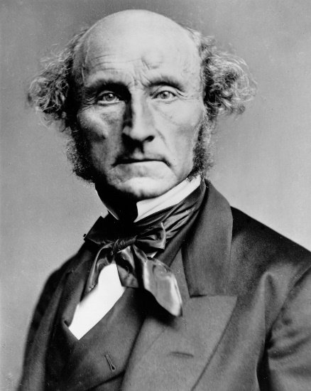
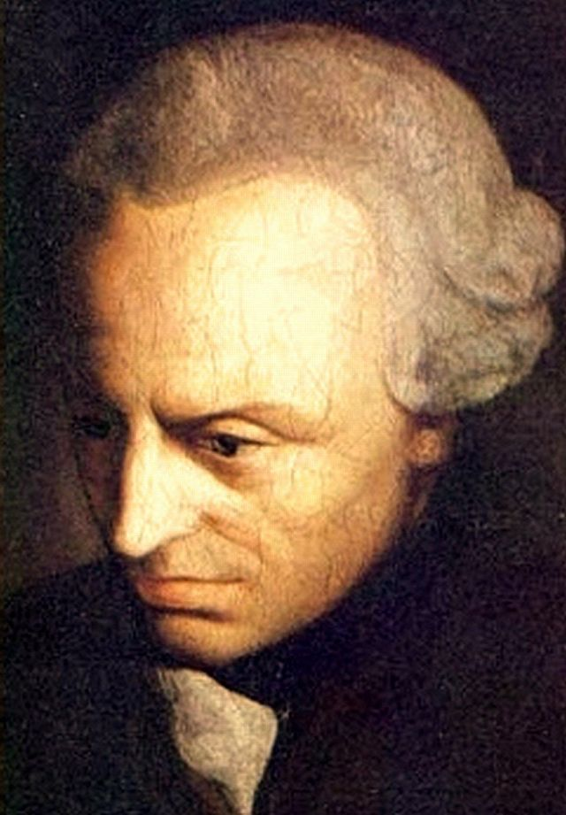
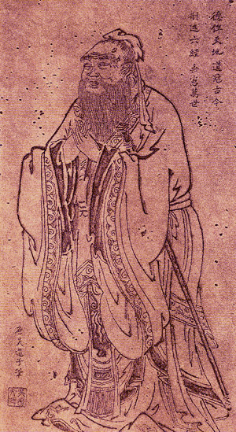
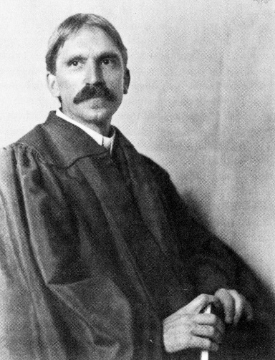
Normative Ethics
Virtue ethics
Stoicism
Hedonism
Cyrenaic hedonism
Epicureanism
State consequentialism
Consequentialism
Utilitarianism
Deontology
Contemporary virtue ethics
Pragmatic ethics
Role ethics
Anarchist ethics
Postmodern ethics

Slide 6
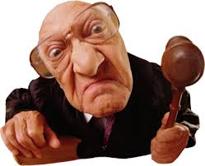
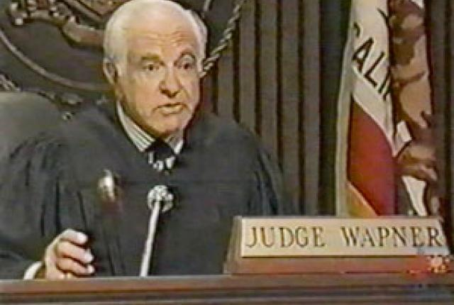
What are we trying to do?

Slide 7
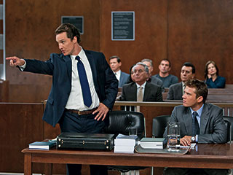
What do we want from Lawyers?

Slide 8
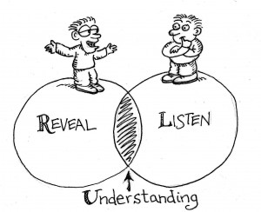
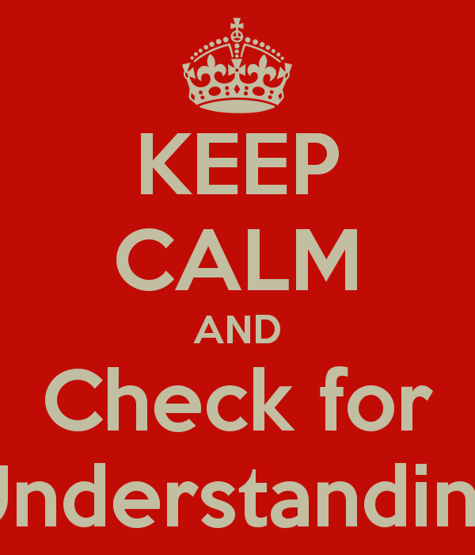
What Are Mediators Trying to Do?
Notes:
ADD SHB CONFESSION SLIDE:
Why love mediation?
Dream of and for mediation
Peace, Love, Wisdom, Oneness, Resolution, Transformation, Yin&Yang, Letting It Happen, Integration of Norms of Justice and Harmony, Wuwei, Purposelessness

Slide 9
Trust

Slide 10
What are We Cultivating?
Talk & Listening
Understanding & Empathy
Insight & Empowerment
Creativity
Realistic Assessment
Decision Making
Truth & Acceptance
Notes:
Why love mediation?
Dream of and for mediation
Peace, Love, Wisdom, Oneness, Resolution, Transformation, Yin&Yang, Letting It Happen, Integration of Norms of Justice and Harmony, Wuwei, Purposelessness

Slide 11
Ethics are Fundamental
Ethical Tenets go to the heart of the mediation process – without them there would be no trust.
If the mediator is a member of the Bar both guiding ethical principles as to mediators and as to lawyers apply. The parties should know that the mediator is not their lawyer.
The mediator and the Parties need to balance the various tenets with due appreciation of the importance of each. In practice they sometimes conflict.

Slide 12
Our Ethics Follow Our Activities
I. SELF-DETERMINATION
II. IMPARTIALITY
III. CONFLICTS OF INTEREST
IV. COMPETENCE
V. CONFIDENTIALITY
VI. QUALITY OF THE PROCESS
AAA/ABA/SPIDR(ACR) MODEL STANDARDS OF CONDUCT FOR MEDIATORS (1994, 2005)

Slide 13
STANDARD I : SELF DETERMINATION
A. A mediator shall conduct a mediation based on the principle of party self-determination. Self-determination is the act of coming to a voluntary, uncoerced decision in which each party makes free and informed choices as to process and outcome. Parties may exercise self-determination at any stage of a mediation, including mediator selection, process design, participation in or withdrawal from the process, and outcomes.

Slide 14
STANDARD I : SELF DETERMINATION
1. Although party self-determination for process design is a fundamental principle of mediation practice, a mediator may need to balance such party self-determination with a mediator’s duty to conduct a quality process in accordance with these Standards.

Slide 15
STANDARD I : SELF DETERMINATION
B. A mediator shall not undermine party self-determination by any party for reasons
such as higher settlement rates, egos, increased fees, or outside pressures from
court personnel, program administrators, provider organizations, the media or
others.

Slide 16
It is the Parties Who Decide Whether to Settle, Not the Mediator
The Parties’ “Informed Consent” should drive the process.
Settlement should not be a goal for the mediator that overrides the Parties’ right to decide. The mediator’s record of achieving settlements is not a proper consideration.
The mediator needs to consider what to do if a Party lacks key information of which the mediator is aware. The mediator cannot provide information to the other party when the mediator has received that information subject to a pledge of confidentiality and must remain neutral. Yet if the mediator does not give the party the information, the Party may not be “informed” in agreeing to settle.

Slide 17
STANDARD IV: COMPETENCE
A. A mediator shall mediate only when the mediator has the necessary competence
to satisfy the reasonable expectations of the parties.
1. Any person may be selected as a mediator, provided that the parties are satisfied with the mediator’s competence and qualifications. Training, experience in mediation, skills, cultural understandings and other qualities are often necessary for mediator competence. A person who offers to serve as a mediator creates the expectation that the person is competent to mediate effectively.
Notes:
BALANCES OBJECTIVE STD AND STD SUBJECTIVE PARTIES

Slide 18
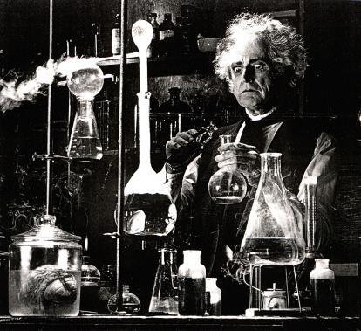
Reality Testing
BATNAs
Risk Assessment
Transaction Cost
Assertion Credibility
Deal Doability
Move’s Viability
Projected Impact

Slide 19
STANDARD II: IMPARTIALITY
A. A mediator shall decline a mediation if the mediator cannot conduct it in an
impartial manner. Impartiality means freedom from favoritism, bias or prejudice.
B. A mediator shall conduct a mediation in an impartial manner and avoid conduct
that gives the appearance of partiality.
NB: BIAS; NEUTRALITY; SEE ALSO: STD III: CONFLICT OF INTEREST

Slide 20
Neutrality and Impartiality
The Parties trust in the impartiality of the mediator is vital.
The mediator should make full disclosure of all known associations and facts that could raise issues as to impartiality even though they may not actually indicate that the mediator will be partial.
In addition to disclosure of what the mediator recalls, reasonable inquiry is necessary as to other matters the neutral thinks could raise reasonable doubts as to impartiality.

Slide 21
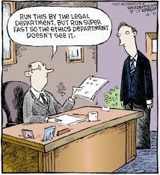
Impartiality (Std 2); Conflicts (Std 3)
Conflicts Check
How much must we research?
In big firms?
Solo?
Linked-In & Other
Social Media?

Slide 22
The Mediator Must Remain Impartial
The mediator cannot act as counsel to either side.
The mediator’s job is not to even things up by helping one side or the other.
If a party is pro se and does not understand a key point, the mediator may suggest that the Party retain counsel rather than counseling the party.
Often the Parties are mediating to avoid having to incur the full expense of litigation and, therefore, they are aware they take the risk that they will not know all the facts.

Slide 23
STANDARD VI: QUALITY OF THE PROCESS
A. A mediator shall conduct a mediation in accordance with these Standards and in a
manner that promotes diligence, timeliness, safety, presence of the appropriate participants, party participation, procedural fairness, party competency and mutual respect among all participants.
Q: WHAT IS THIS NOTION OF QUALITY?

Slide 24
STANDARD VI: QUALITY OF THE PROCESS
4. A mediator should promote honesty and candor between and among all participants, and a mediator shall not knowingly misrepresent any material fact or circumstance in the course of a mediation.

Slide 25
STANDARD VI: QUALITY OF THE PROCESS
5. The role of a mediator differs substantially from other professional roles. Mixing the role of a mediator and the role of another profession is problematic and thus, a mediator should distinguish between the roles. A mediator may provide information that the mediator is qualified by training or experience to provide, only if the mediator can do so consistent with these Standards.

Slide 26
STANDARD VI: QUALITY OF THE PROCESS
6. A mediator shall not conduct a dispute resolution procedure other than mediation but label it mediation in an effort to gain the protection of rules, statutes, or other governing authorities pertaining to mediation.

Slide 27
STANDARD VI: QUALITY OF THE PROCESS
7. A mediator may recommend, when appropriate, that parties consider resolving their dispute through arbitration, counseling, neutral evaluation or other processes.

Slide 28
STANDARD VI: QUALITY OF THE PROCESS
8. A mediator shall not undertake an additional dispute resolution role in the same matter without the consent of the parties. Before providing such service, a mediator shall inform the parties of the implications of the change in process and obtain their consent to the change. A mediator who undertakes such role assumes different duties and responsibilities that may be governed by other standards.

Slide 29
Evaluation, Direction & Impact
Standard 1 – Self Determination
If not in Court setting & Evaluation is Sought by Parties/Counsel…
Standard 4 - Competence
Standard 6 - Quality of the Process
E.g.: Unlicensed K’or – no legal right to payment…

Slide 30
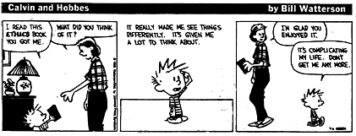
Lying – Stds 1, 6
By Parties
By Counsel - fact, law?
By Mediator
Manipulation

Slide 31
Preserve the Honesty and Integrity of the Process
The Parties and Counsel should be honest in their statements and correct misstatements.
Bargaining should be in good faith.
Depending on the law of the state, if the mediator is a lawyer he/she may be required to disclose misconduct by counsel. If the mediator believes there has been such misconduct, before disclosing it he/she needs to consider the effect of any disclosure on the mediation process and the obligation to maintain confidentiality.
Parties may properly leave some things undisclosed.
True bargaining positions.
Important facts not known to the other side.
The mediator may need to withdraw to avoid involvement in a process that is no longer honest.

Slide 32
Confidentiality

Slide 33
STANDARD V. CONFIDENTIALITY
A. A mediator shall maintain the confidentiality of all information obtained by the mediator in mediation, unless otherwise agreed to by the parties or required by applicable law.
1. If the parties to a mediation agree that the mediator may disclose information obtained during the mediation, the mediator may do so.

Slide 34
Confidentiality Should Be Preserved by the Mediator
The mediator must keep confidential what is said.
What is discussed in a separate caucus is to be kept confidential absent consent by the Parties in that caucus.
It is best if the Parties and counsel also preserve confidentiality, but that may not be assured.

Slide 35
The Cone of Silence

Slide 36
Zealous Advocacy
Substitution of Norms of Diligence & Competence
The New Lawyer – The Collaborative Practice Model

Slide 37
Wells Fargo
Hon. Cecelia G. Morris
What is Good Faith Participation?
What May Courts Enforce?

Slide 38
Good Faith = Active Participation
Gestalt of Wells Fargo Pecadillos:
At a loss fully to understand issues
Tell us issues in advance
“No” to “any other issues”
Tell us Who is Attending
Worried re “free for all” & “waste of time”
Junior Representative (VP, Sr. Banker for Client)
Junior Attorney (10 year associate)
Mantra: no $ from our pocket; Interruptions
No Risk Analysis; “link” avoidance
Report? 2 of us, 1 of you; Not using you again!
Sole Offer – only after Court hearing (& low)
Offer only after long call with mystery person

Slide 39
Wells Fargo
Hon. William H. Pauley, III, DJ
Good Faith =
Submit Pre-Mediation Statement
Attend with Full Settlement Authority

Slide 40
Wells Fargo
Who Controls the Process?
(Per SDNY BR Ct.: the Mediator)
Is Risk Analysis Fundamental to Mediation?
What is Integrity?

Slide 41
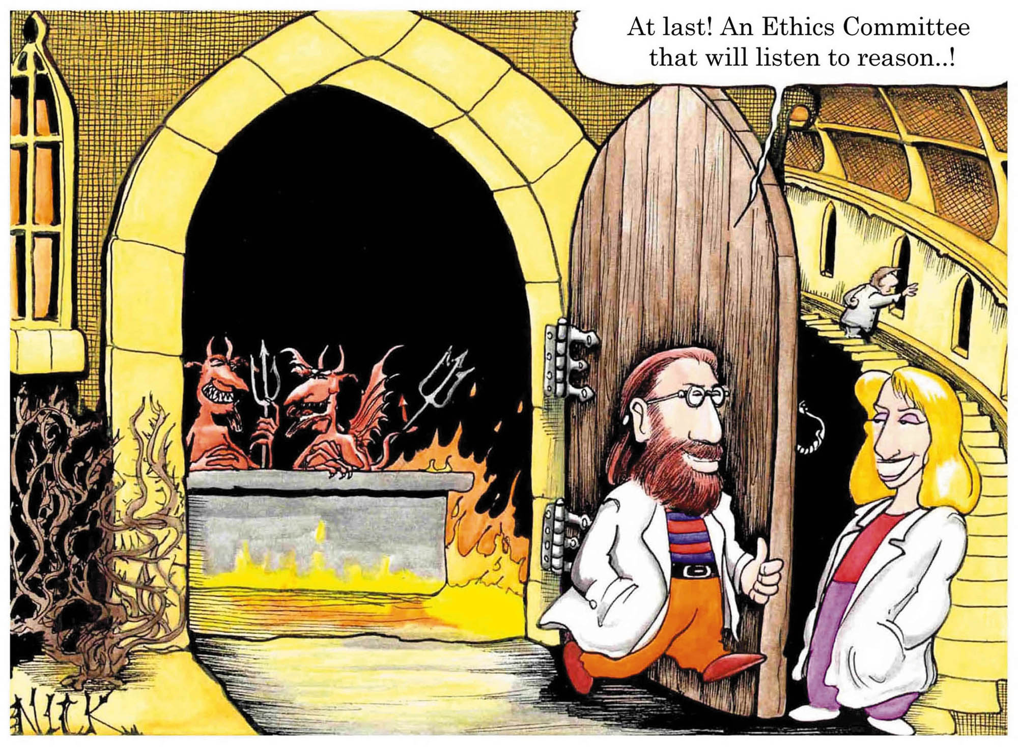
Advertising – Std 7
Selection Process
Style disclosure

Slide 42
Candor in Advertising
If put forward, statements as to the mediator’s record should be accurate.
Statements made should not breach the pledge of confidentiality.

Slide 43
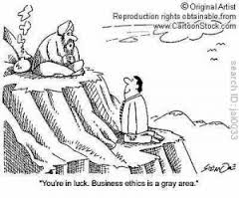
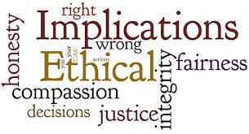
Compensation – Std 8
Commercial Division
EDNY
NJ CDR

Slide 44
STANDARD IX: ADVANCEMENT OF MEDIATION PRACTICE
A. A mediator should act in a manner that advances the practice of mediation…
Notes:
To SHB:, underlying this is Furtherance of Mediation Field. How will manipulative behavior affect public perception of mediation? How will it affect practices by other mediators?? We influence each other. Stories by parties (including parties happy with having been manipulated), can lead to imitation, as well.

Slide 45
Notes:
FLASH FOLLOWING ETHICAL QUESTION POSED BY KNOWING 2ND MEDIATOR IN SCENARIO VI.

Slide 46
The parties ask the mediator for her legal opinion on the issues raised by the case.
How should the mediator respond?

Slide 47
A mediator learns that a company has been committing tax fraud by knowingly charging personal expenses to his company.
Does the mediator have a duty to take any particular action?
What are the ethical duties of the mediator under these circumstances?

Slide 48
The parties have reached an impasse. The parties ask the mediator to change hats and serve as arbitrator.
How should the mediator respond?
What should be the response in the converse situation where the neutral was initially engaged as an arbitrator and after the first day of the hearing the arbitrator was asked to suspend the arbitration and instead serve as a mediator?

Slide 49
Years ago the mediator and the claimant’s counsel opposed each other in a forgettable litigation. It was so forgettable that the mediator forgot the particulars except to recall that it was approximately 10 years ago.
Is a disclosure necessary?
If so, what needs to be said?
What effort, if any should be made to recover what has been forgotten?
Is the answer different if the litigation in question took place last year?

Slide 50
You are a litigator who occasionally serves as a mediator. Your newest mediation pits two large financial institutions against each other. Your spouse works for a major law firm in town. You believe your spouse’s firm represents one of the parties on a regular basis, but you do not believe your spouse has ever represented that party.
What should you do?

Slide 51
You are a mediator with a private legal practice. During a caucus, the General Counsel for one of the parties indicates, in a one-on-one conversation with you, that she is always looking for good lawyers and to give her a call after the mediation to discuss possible opportunities.
What should you do?

Slide 52
In an introductory caucus, claimant’s counsel threatens to disclose in the context of mediation the marital infidelities, addictions, and sexual predilections of several respondent’s senior executives.
What should the mediator do in response, if anything?

Slide 53
An unsophisticated party, with unsophisticated counsel, is inclined to accept an offer based on a misunderstanding of the underlying legal principles that severely undervalues that party’s case.
Does the mediator have any obligation - ethical or otherwise - to educate that party?

